Slide 1
July 2025

Slide 2
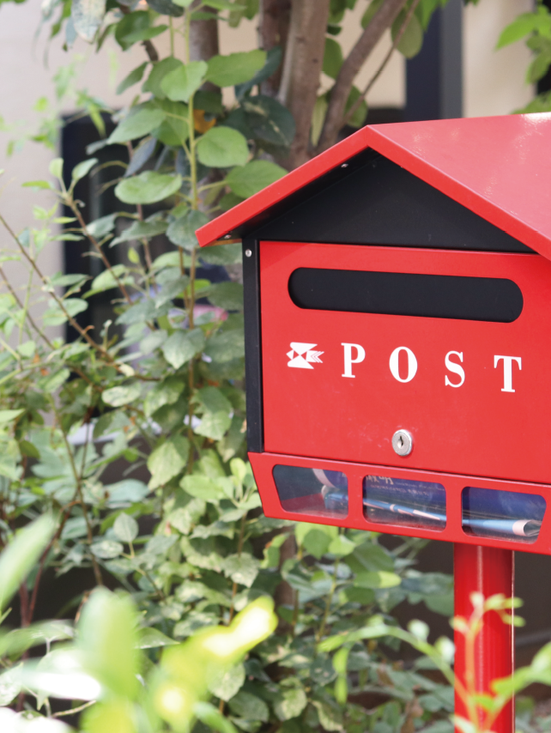
Korea Post
Korea Post, as a government organization,
affiliate of the Ministry of Science and ICT,
provides Postal, Savings, and Insurance services
to the public via nationwide network
Postal
Savings
Insurance

Slide 3
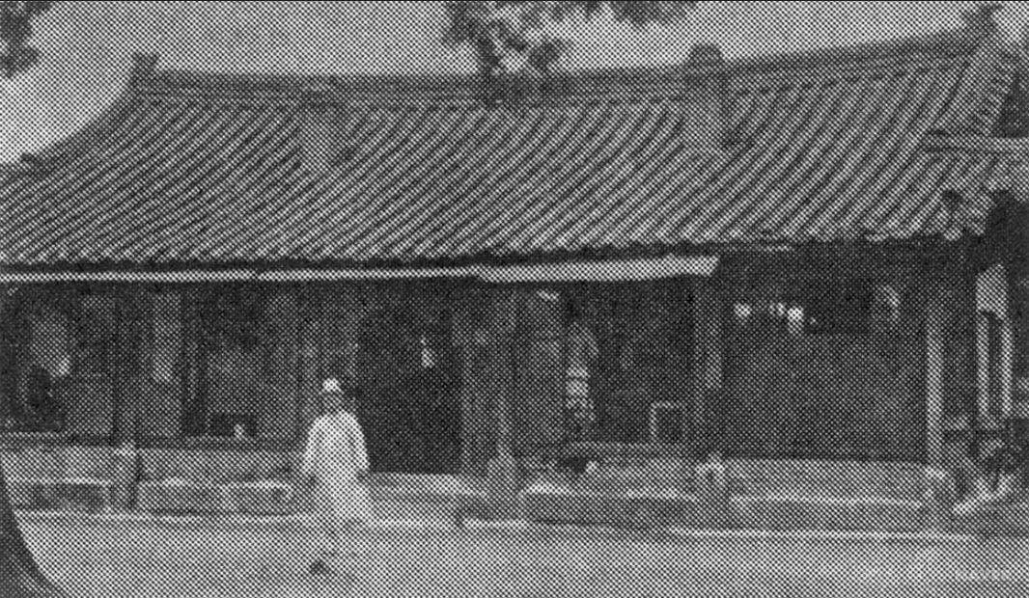
Korea Post
Achieved continuous growth for the last 140 years
since its foundation in 1884 as a modernized government institution
Annual Budget KRW 12 trillion / 8.9B$ (’25)
Nationwide network
- Headquarters, 9 Regional Offices,
3,300 Post Offices,
43,000 employees
- The sole central government agency
with direct contact with the public

Slide 4
Korea Post’s Corporate Identity (CI) features a swallow,
a bird long regarded by the Korean people
as a symbol of good fortune and familiarity in everyday life

Slide 5
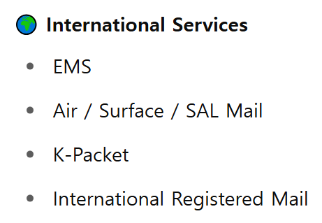
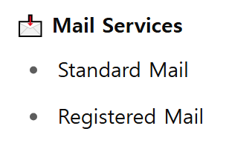
Korea Post Postal Service
ePacket

Slide 6
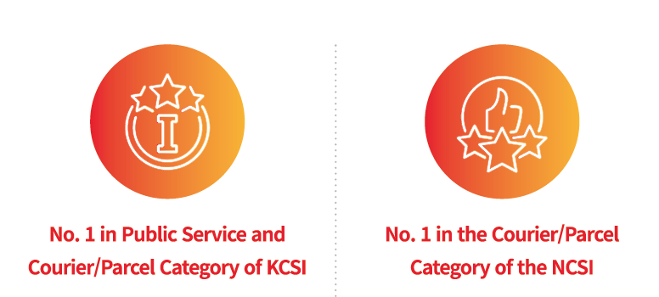
Korea Post Postal Service

Slide 7
Recent Participating in Meeting
13th APPU Congress
2024 APPU Postal Business Forum
EMS Symposium
Meeting with EMS Coop Head in Korea

Slide 8
Recent Achievement on Mail(EMS)
Korea Post is working to improve the mail performance

Slide 9
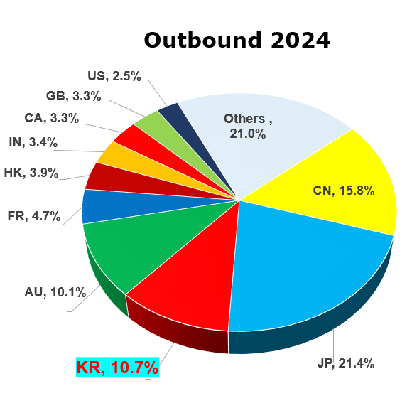
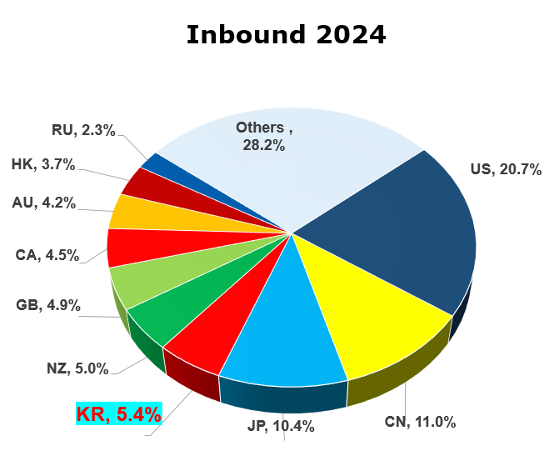
Recent Achievement on Mail(EMS)
Korea Post also sends and receives large quantities of mail

Slide 10
Developments for Future:
Expansion Facilities
Origin Zone
Expansion Zone
Korea Post is working to increase processing volume and improve performance
by expanding OE

Slide 11
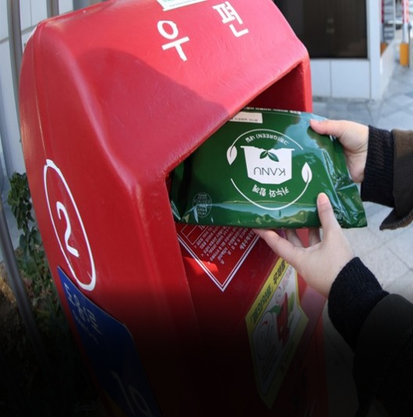
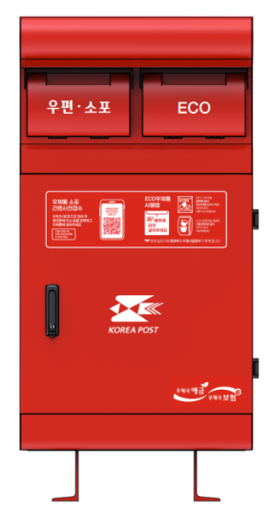
Developments for Future:
Sustainable Business
Korea Post is implementing the collection service for coffee capsules
and waste medicines
to support sustainable environment

Slide 12
Korea for POC & CA 2026-2029

